Slide 1
STOMACH

Slide 2
Functions of the stomach
■ To continue the digestion of carbohydrates initiated by
the amylase of saliva.
■ To add an acidic ﬂuid to the ingested food and mixing its
contents into a viscous mass called chyme by the churning activity of the muscularis.
■ To begin digestion of triglycerides by a secreted lipase, and
■ To promote the initial digestion of proteins with the
enzyme pepsin.

Slide 3
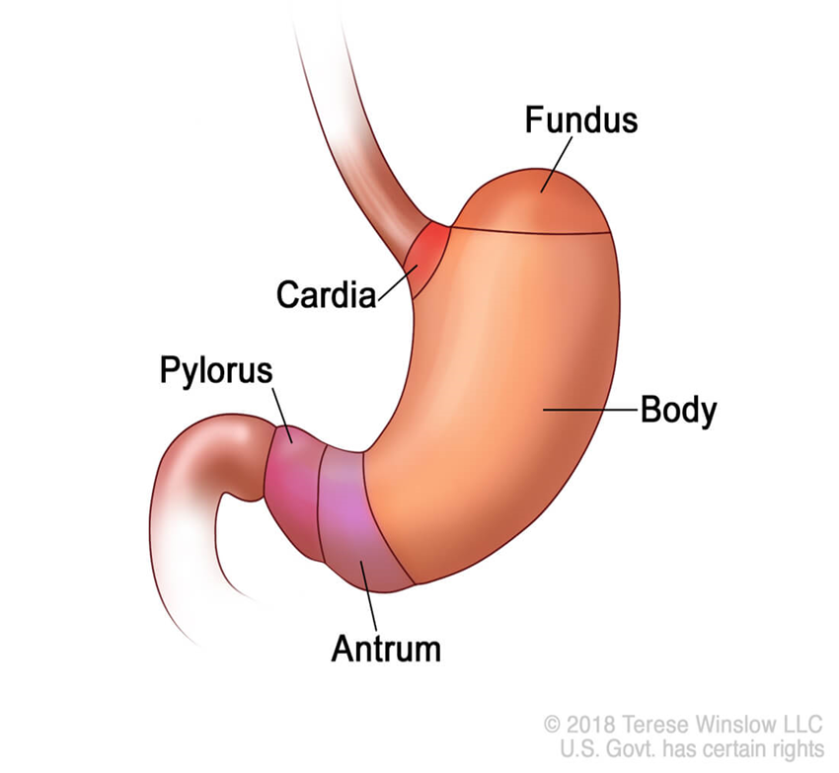
REGIONS OF THE STOMACH
The stomach divided into four main regions:
1- The cardia: surrounds the esophagus, narrow transitional zone.
2- The fundus and 3-the body: is the largest part, are identical in
microscopic structure and are the sites of gastric glands releasing acidic gastric juice.
4- The pylorus: the funnel-shaped region that
opens into the small intestine.
The cardia and pylorus are primarily
involved with mucus production and are histogically similar.

Slide 4
General plan of GIT tubes
Muscularis

Slide 5
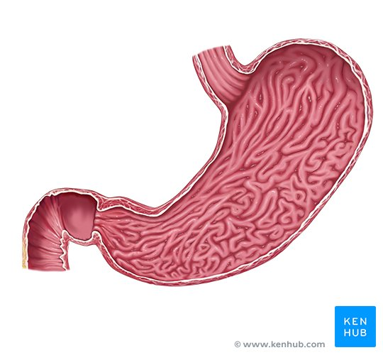
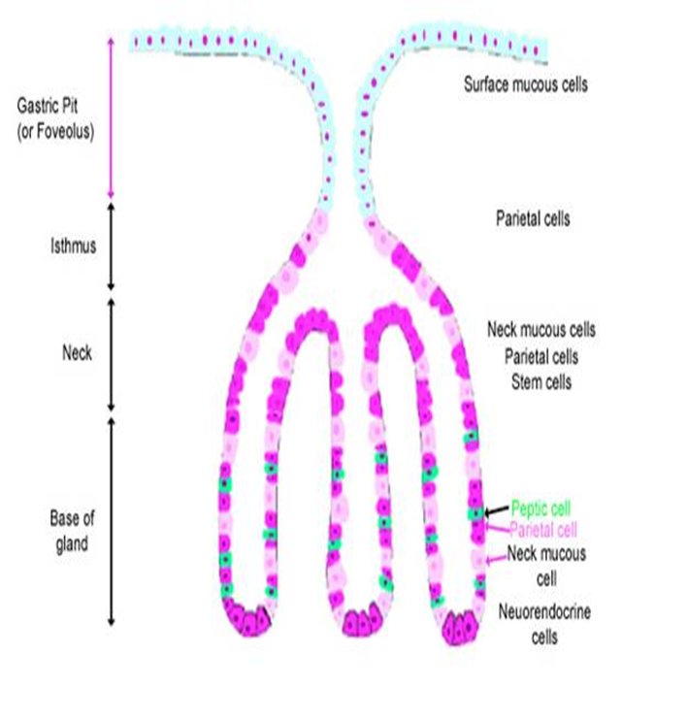
How does the stomach adapt to its functions?
1- The mucosa and the submucosa of the empty stomach show longitudinal folds (gastric rugae) which disappear in the distended state (expansion) of the stomach when it is filled with food.
2- The mucosal surface of the stomach is invaginated into the lamina propria forming gastric pits.
3- The lamina propria contains large number of simple branched tubular glands (gastric glands) which open into the bottoms of the pits.

Slide 6
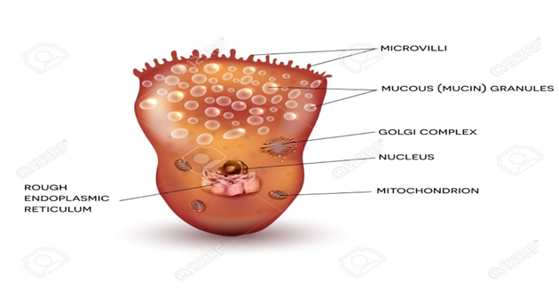
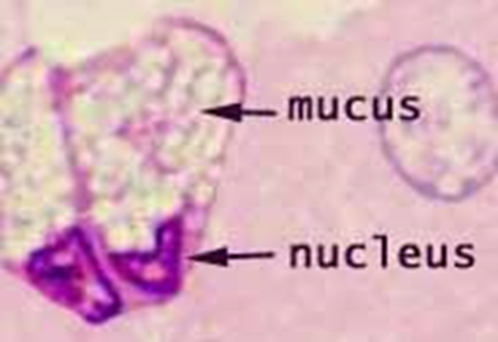
1- Mucosa
I- Fundic mucosa:
It is characterized by short and narrow gastric pits (occupy 1/5 of the length of the mucosa).
It consists of:
A- The surface epithelium: lined by the surface mucous cells (which also cover the pits):
Shape: tall columnar cells with pale apical parts.
Function: secrete a thick, adherent, and highly viscous mucous layer, which is rich in bicarbonate ions and protects the mucosa from both abrasive eﬀects of intraluminal food and the corrosive eﬀects of stomach acid.

Slide 7
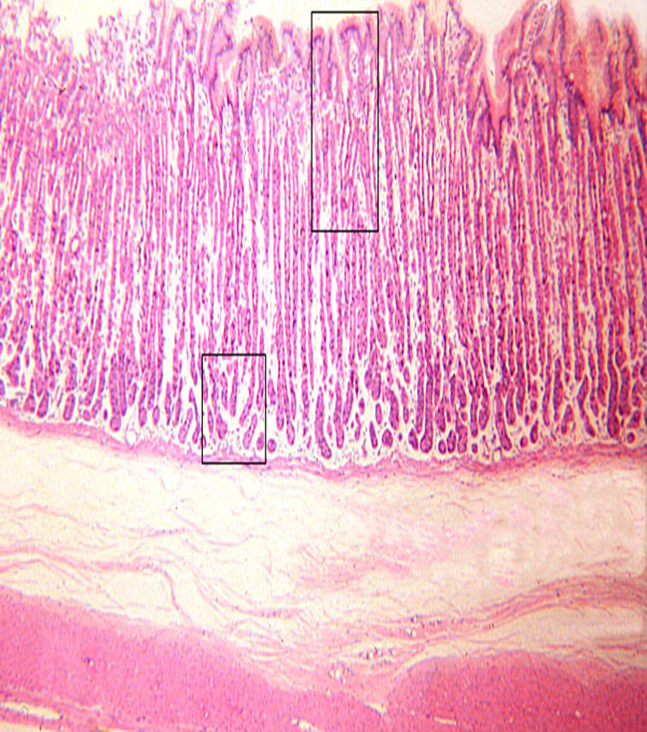
B- The lamina propria: contains large number of fundic glands that secrete the gastric juice. The glands are surrounded by little amount of connective tissue.
C- Muscularis mucosae.
The fundic glands of the stomach:
Type: simple branched tubular glands.
Appearance: closely packed, extending throughout the full thickness of the mucosa with minimum amount of CT in between.
Lining cells: 5 types.

Slide 8
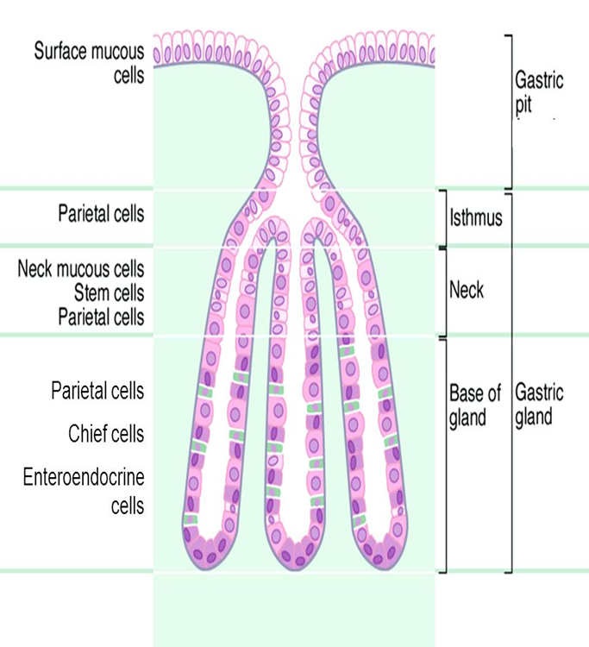
The fundic glands of the stomach
Each gland is divided into:
A- Upper part: lined by mucous neck & stem cells (2 cells).
B- Middle part: lined mainly by parietal cells.
C- Base: lined mainly by peptic, enteroendocrine. (2 cells).

Slide 9
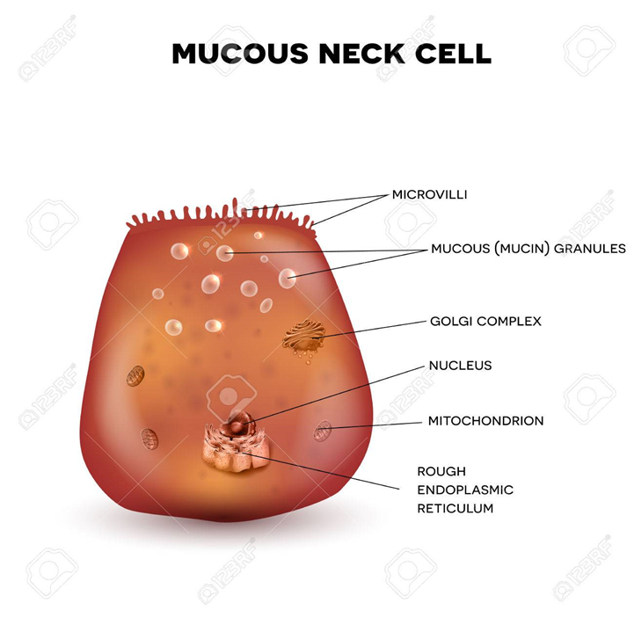
1- The mucous neck cells
Site: in the upper part of the fundic gland , are present mainly clustered but also
occur singly among the other cells in the necks of gastric glands and include many progenitor and immature surface mucous cells.
Shape: low columnar , Less columnar than the surface mucous cells lining the gastric pits, have round nuclei and apical secretory granules.
Function: secrete soluble mucus to lubricate the gastric content , Their mucus secretion is less alkaline than that of the surface epithelial mucous cells .

Slide 10
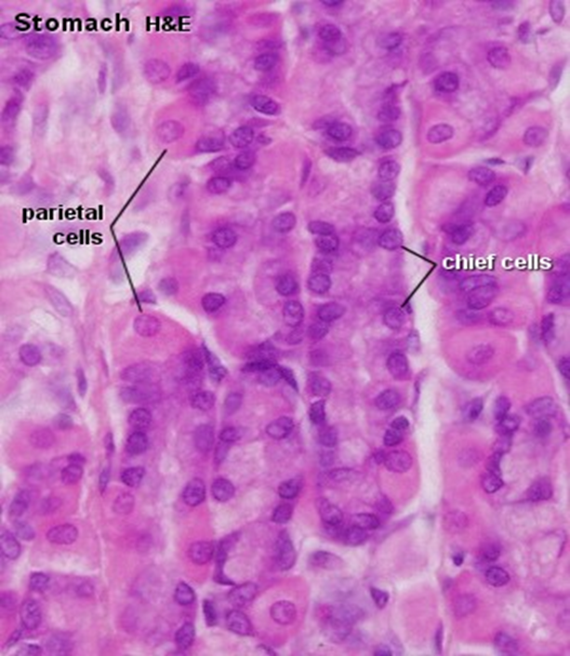
2- Oxyntic cells = parietal cells:
Site: mainly in the middle part of the gland.
Functions:
1- Secrete HCL
2- Secrete the intrinsic factor for vitamin B12 absorption.
Structure:
LM:
Shape: large cells, usually appearing rounded or pyramidal.
Nucleus: rounded.
Cytoplasm: deep acidophilic due to the high density of mitochondria .

Slide 11
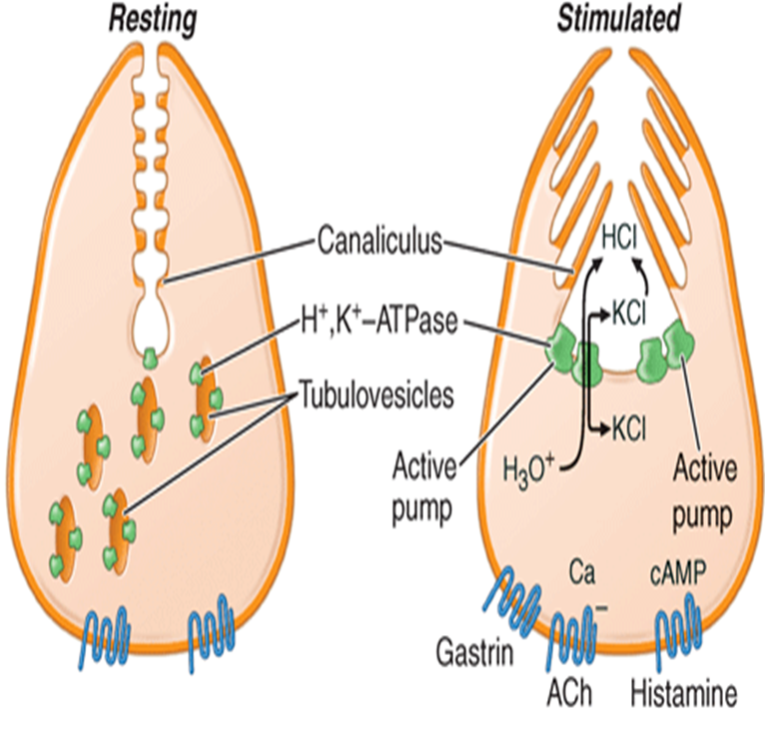
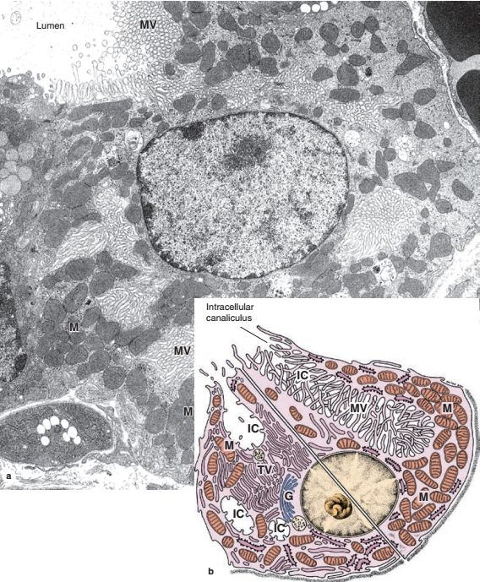
How does the oxyntic cell adapt to its function?
The parietal cell has an ultrastractures help to adapt its function include:
1- They have intracellular canaliculi: deep invaginations of the apical plasma membrane into the cytoplasm, connected with the lumen of the gastric gland & bear numerous microvilli increase surface area for an active ion pump.
2- Tubulovesicular system: it is a reservoir of plasma membranes contain proton pump:
In active state: membranes of the tubulovesicular system decrease(inserted into the wall of the canaliculi forming numerous microvilli).
In resting state: membranes increase, microvilli decrease.
3- Numerous mitochondria energy for active ion pump.

Slide 12
Synthesis of HCL by the parietal cells
1.Water (H2O) within the parietal cell is split into a hydrogen ion (H+) and a hydroxide ion (OH–).
2.H+ is pumped into the lumen of the gastric gland by an H+/K+ pump.
3.OH– bonds with carbon dioxide (CO2) to form bicarbonate ion (HCO3–).
4. An exchange occurs as HCO3– is transported out of the parietal cell (HCO3– then enters the blood), while chloride ion (Cl–) is transported into the parietal cell; Cl– then enters the lumen of the gastric gland.
5. Within the lumen of the gastric gland, Cl– combines with H+ to form hydrochloric acid (HCl).

Slide 13
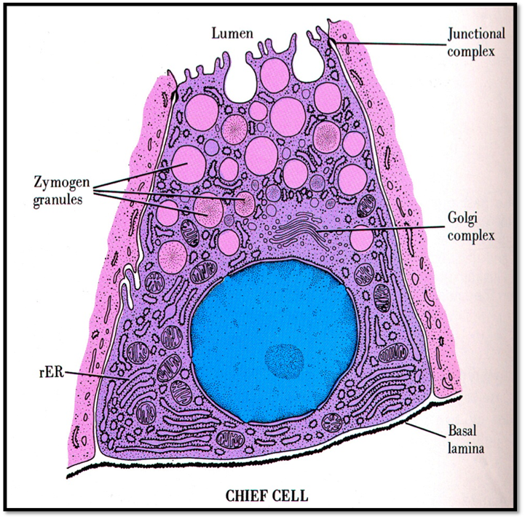
chief cells=Peptic cells =zymogenic cells
Number: the most numerous cells.
Function: secrete pepsin & gastric lipase.
Site: present mainly in the base of the gland.
Structure:
LM: pyramidal cells with a basal basophilic cytoplasm & apical acidophilic granules(zymogen granules).
How does the peptic cell adapt to its function?
EM: protein secreting cells:
1- Basal rER.
2- Supranuclear Golgi complex.
2- Apical secretory granules.

Slide 14
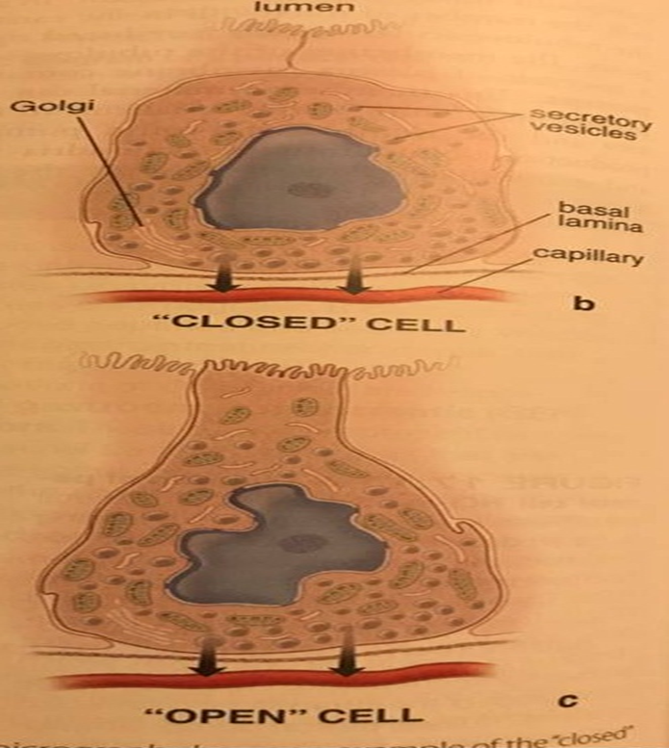
4- Enteroendocrine cells
Site: mainly in the base of the gland.
Function: They belong to the diffuse neuroendocrine system; secrete peptide hormones.
In the fundus small enteroendocrine cells secreting serotonin (5-hydroxytryptamine) are found at the basal lamina of the gastric glands
In the pylorus other enteroendocrine cells are located in contact with the glandular lumens, including G cells producing the peptide gastrin
Structure:
LM: pale, they are best visualized by immunohistochemical staining for their peptide hormones.
EM:
Of 2 types : either closed type (do not reach the lumen) or open type (reach the lumen by their microvilli).
Pyramidal cells with basal secretory granules (WHY).

Slide 15
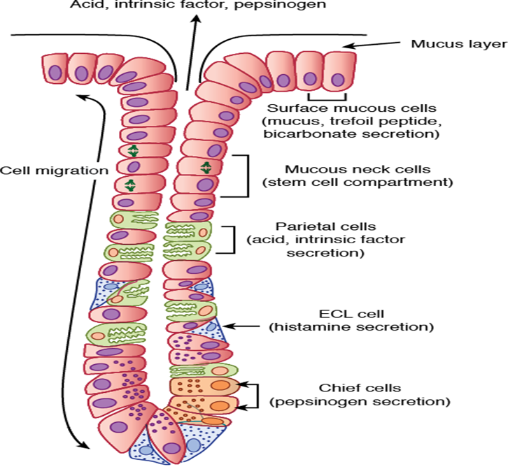
5- Stem cells
Site: mainly in the upper part of the gland.
Function: They proliferate and move upward to differentiate into the surface mucous cells or downward to differentiate into all other cells lining the gastric glands.
Structure: low columnar cells with mitotic figures.

Slide 17
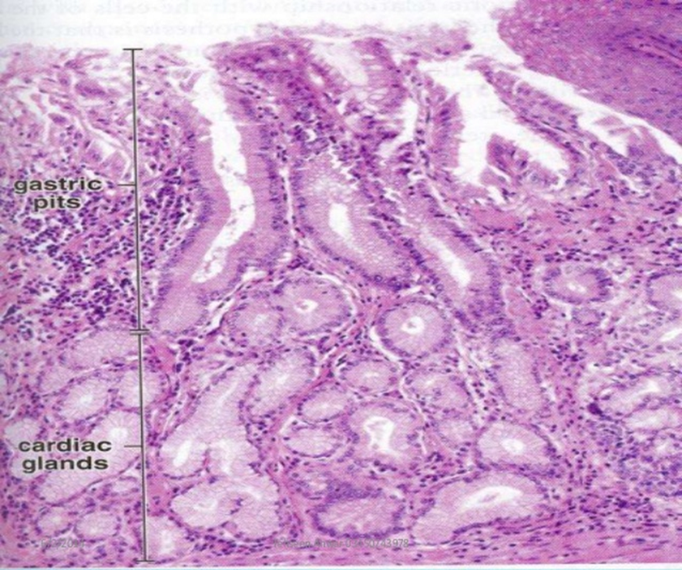
II-Mucosa of the cardia:
1- Shallow gastric pits, lined by surface mucous cells.
2- The lamina propria contains simple branched coiled tubular glands lined mainly by mucus secreting cells.
Function :Together with mucosal esophageal glands, they protect epithelium against gastric reflux.

Slide 18
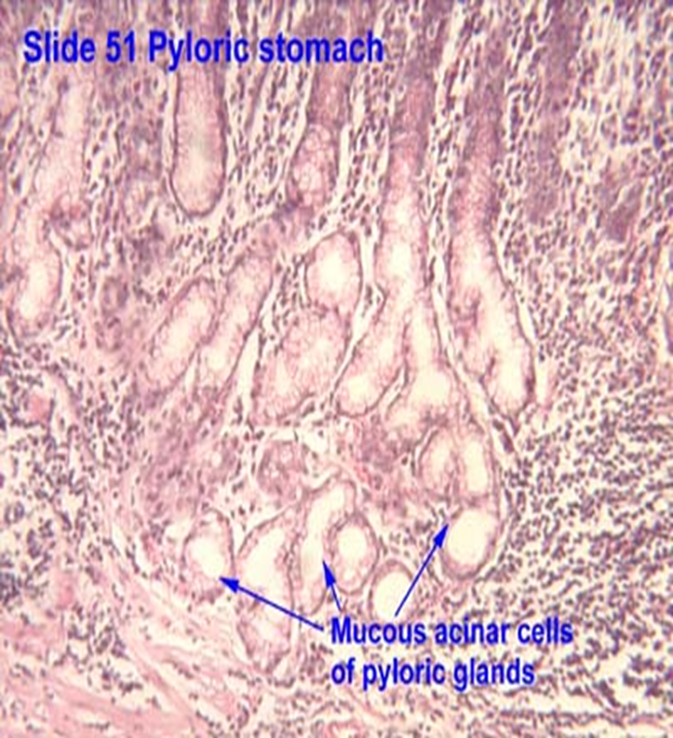
III- Pyloric mucosa
1- Wide and deep gastric pits (occupying more than ½ of the length of the mucosa).
2- The lamina propria contains the simple branched coiled tubular glands which are lined mainly by mucus secreting cells and some enteroendocrine cells ( especially those secreting gastrin).

Slide 20
The submucosa
composed of connective tissue with large blood and
lymph vessels and many lymphoid cells, macrophages, and
mast cells.

Slide 21
The muscularis and the serosa
Has three poorly defned layers of smooth muscle: an outer longitudinal layer, a middle circular layer, and an innermost oblique layer.
In the pylorus: the circular smooth muscle layer ( the middle layer)is thickened to form the pyloric sphincter.
Rhythmic contractions of the muscularis thoroughly mix ingested food and chyme with
mucus, HCl, and digestive enzymes from the gastric mucosa.
serosa:
The stomach is covered by a thin serosa.

Slide 22
THANKS

